Slide 1
Week5-Data Visualization using Matplotlib
Wenzheng Li

Slide 2
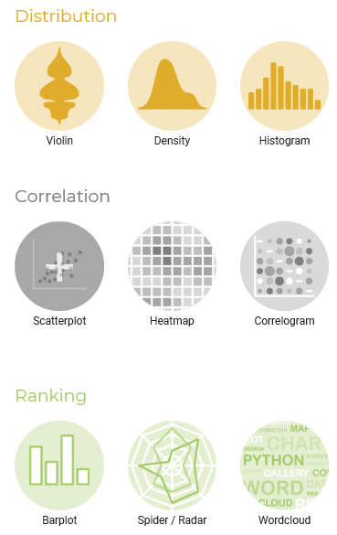
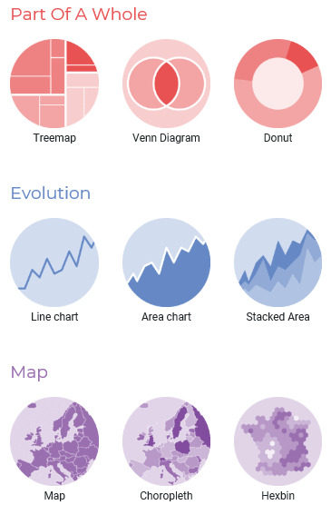
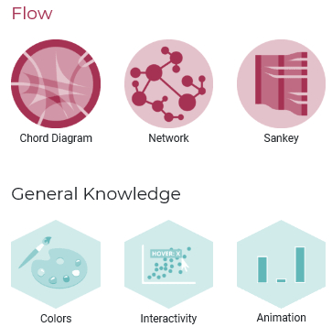
Python Data Visualization — different types of plotting
Source: https://python-graph-gallery.com/

Slide 3
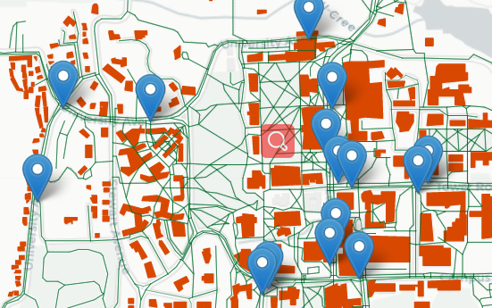
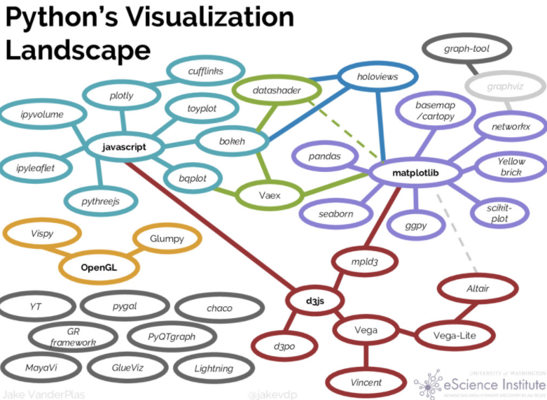
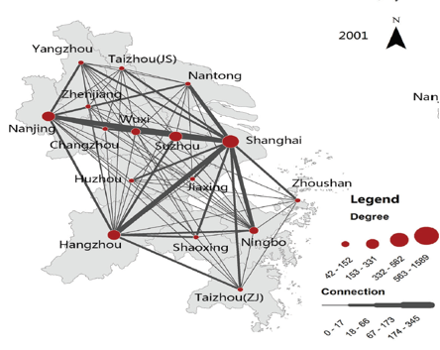
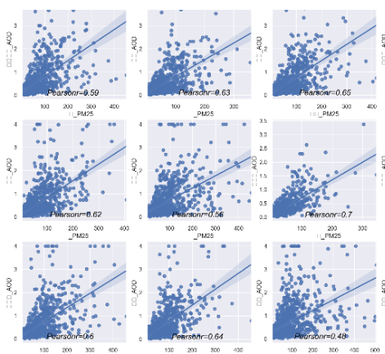

Slide 4
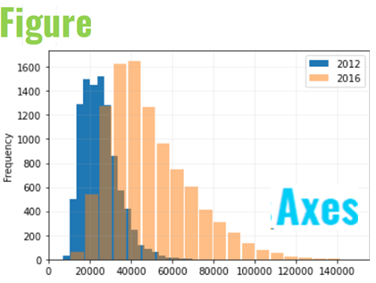
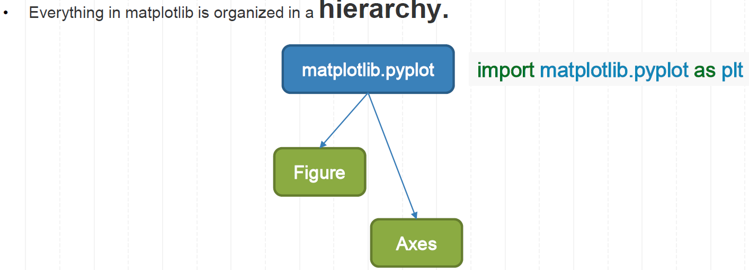
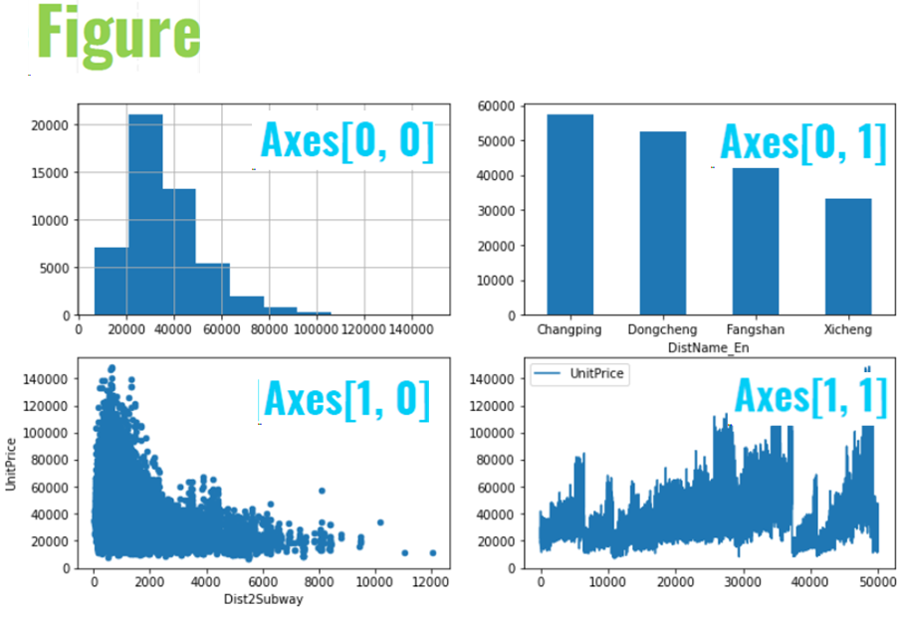
Introduction of Matplotlib
No.1
A basic canvas generated by the matplotlib library consists of the following two components:
figure:
The whole figure.
A figure can contain any number of Axes, but to be useful should have at least one.
a smattering of 'special' artists (titles, figure legends, etc.).
Axes:
This is what you think of as ‘a plot’, it is the region of the image with the data space.
a given Axes object can only be in one Figure.
an Axes contains two (or three in the case of 3D) Axis objects. Each Axes has a title, an x-label, and a y-label.
No.2

Slide 5
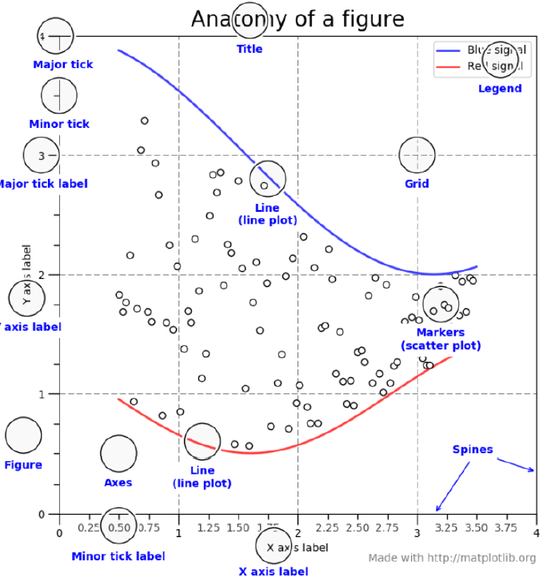
Elements in Matplotlib
A Figure with one Axes

Slide 6
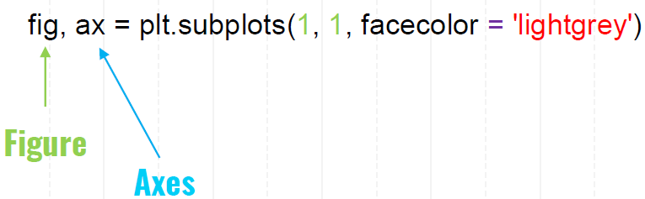
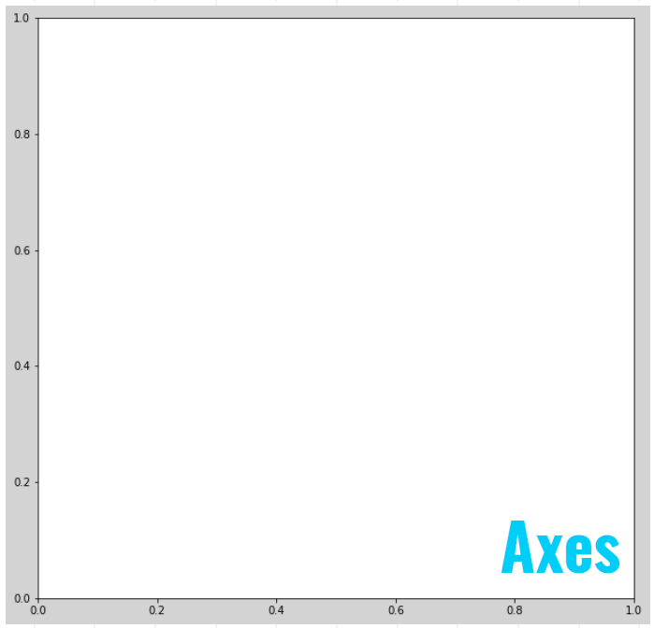

To create a basic plot, we need to define the figure and axes:

Slide 7
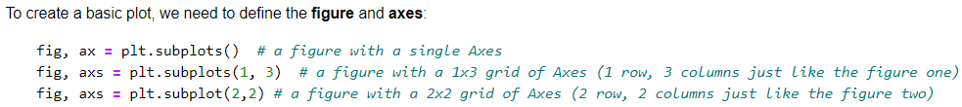
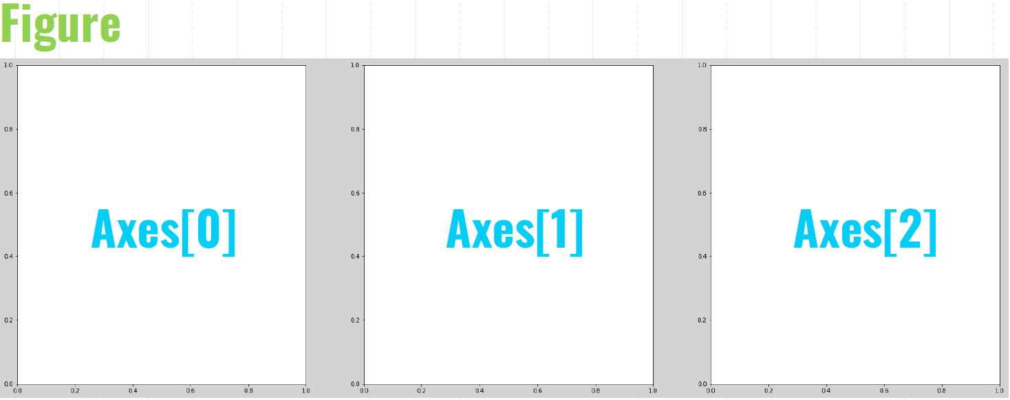

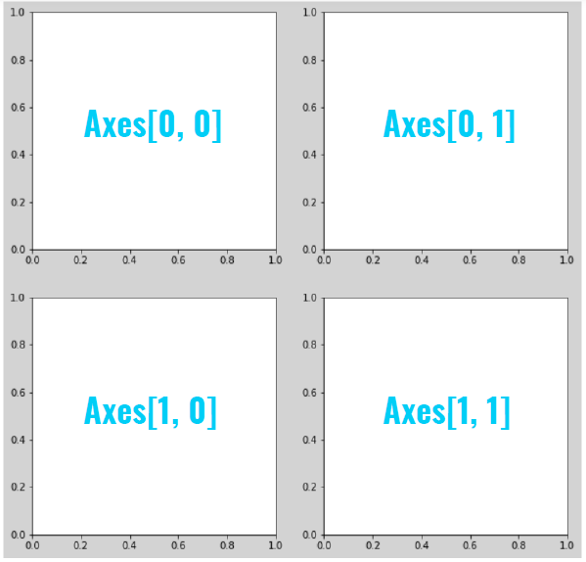
A combined Figure includes multiple Axes:
The whole figure consists of three axes:
The whole figure consists of four axes:

Slide 8
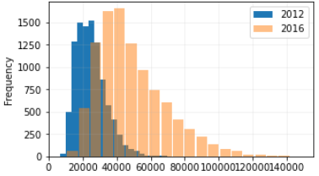
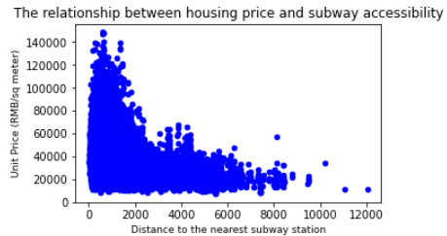
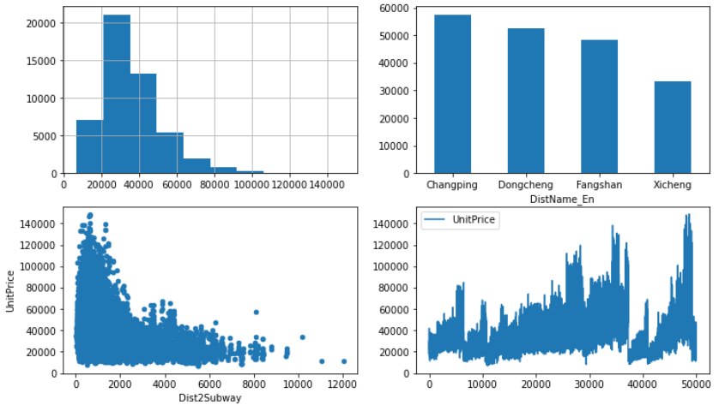
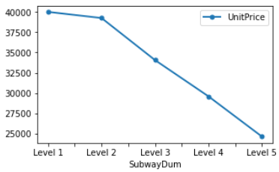
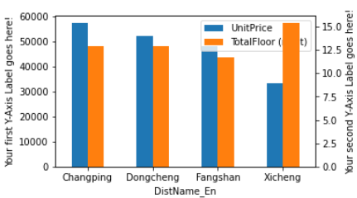
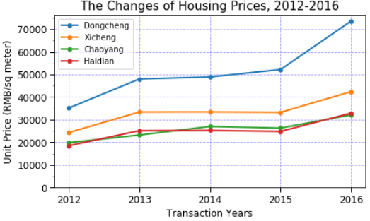
In-class Demo

Slide 9
Thanks! Wenzheng Li (wl563@cornell.edu)
Help Materials:
The codes for various ploting examples: https://matplotlib.org/gallery/index.html
For matplotlib cheat sheet: https://github.com/matplotlib/cheatsheets/blob/master/cheatsheets.pdf
The Python Graph Gallery: https://python-graph-gallery.com/
Insights & Stories
Example: Census Bureau Infographics & Visualizations Gallery https://www.census.gov/library/visualizations.html
Example: Demographics Research Group https://demographics.coopercenter.org/index.php/dataviz

